Slide 1
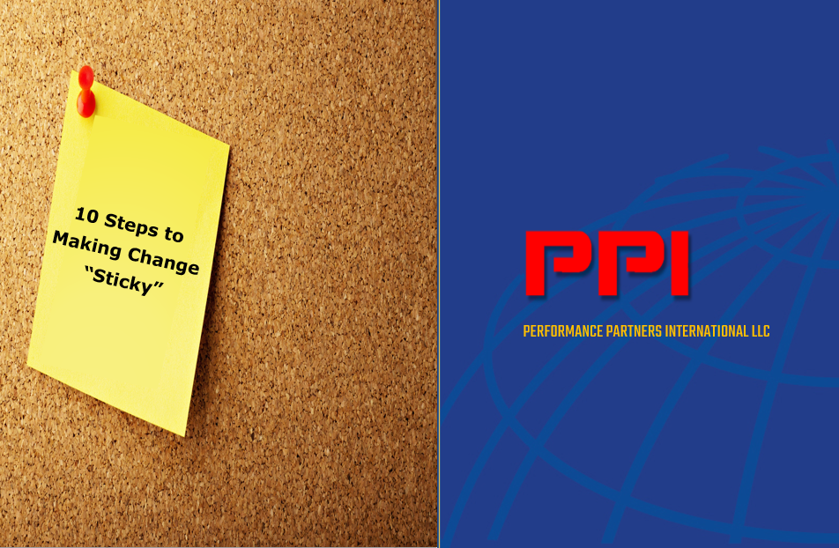

Building A Cascading Performance Management System
WHERE STRATEGY MEETS PERFORMANCE
Notes:
Welcome everyone…
On behalf of CEP, I want to thank you all for participating in today’s webinar on Building a Best Practice Performance-Based Organization.
We’ve been both delighted and a bit surprised with the overwhelming response to this event.
I think that speaks to the relevance and importance of this topic to the Training and HR communities.
A couple of housekeeping notes before we begin…
At the end of our session today we’ll ask you to complete a very brief survey giving us your feedback on this event. Following that survey, you’ll be able to request additional information, including a copy of today’s presentation.
If you have questions at any time during our session please email them to us. We won’t be answering questions live but we will definitely get back to you with an answer. So now, let’s begin….

Slide 2

10 Steps to Making Change “Sticky”
Honor the strengths of your existing culture
Building from current culture core strengths
Current |  | Future
Mixed potential | ∆ | Full potential
Results driven | = | Results driven
Task oriented | + | People oriented
Transactional | + | Transformational

Slide 3

10 Steps to Making Change “Sticky”
Assess and develop critical management behaviors
Areas for development
Building Alignment
Being Receptive
Building Alignment
Being Encouraging
Building Alignment
Exchanging Perspectives
Championing Execution
Offering Praise
Dismissive of Opinions?
Negative Body Language?
Lacking Show of Appreciation?
Disallowance of Concerns?
Discourage Discussion?
Inflexible During Change?
Rarely recognize Contributions?
Unlikely to Give Praise?

Slide 4
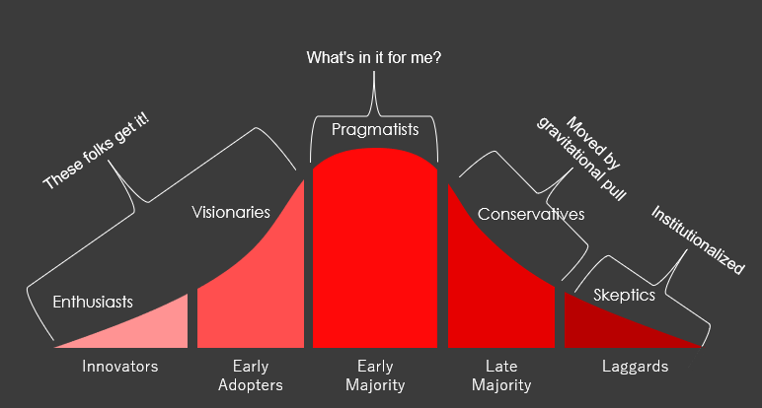
How Adults Learn
How do we make culture change “sticky”
10 Steps to Making Change “Sticky”
How Adults Learn
Aim for influencing a critical mass
CRITICAL MASS

Slide 5
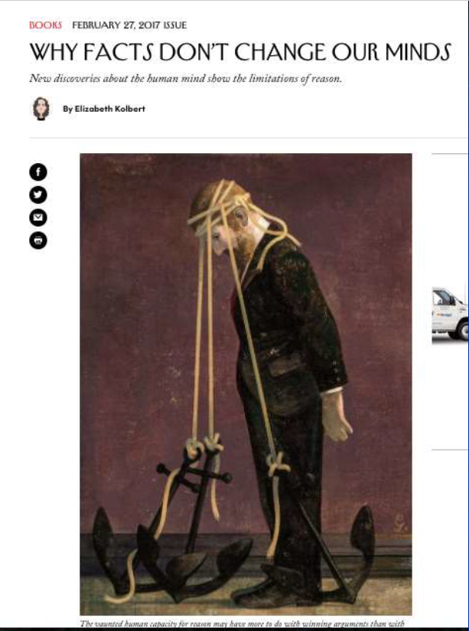
How Adults Learn
How do we make culture change “sticky”
10 Steps to Making Change “Sticky”
How Adults Learn
Use a thorough understanding of human behavior
“Confirmation Bias”,
the tendency people have to embrace information that supports their beliefs and reject information that contradicts them.

Slide 6






How Adults Learn
How do we make culture change “sticky”
10 Steps to Making Change “Sticky”
How Adults Learn
Appeal to personal motivations
Work behavior keys:
Esteem
Social
Safety & Security
Physiological
Self
Actualization
Recognition (I’m Achieving)
Relevance (I’m Important)
Acceptance (I’m OK)
Security (I’m Stable)
Notes:
Look for the dominant one(s) what drives them

Slide 7

How Adults Learn
How do we make culture change “sticky”
9 Steps to Making Change “Sticky”
Teach using your personal success story
Information is 20x more memorable when given through a story
Notes:
Your Daily Practice lab

Slide 8


How Adults Learn
How do we make culture change “sticky”
10 Steps to Making Change “Sticky”
How Adults Learn
Role model the behaviors you are looking for
Many people never had a role model in their life
Consequently, many people never learned successful behaviors for the workplace
If you fill that void, most people will live up to your faith in them
Notes:
Complexity of mental processing (CMP)

Slide 9

How Adults Learn
How do we make culture change “sticky”
10 Steps to Making Change “Sticky”
Make it part of the daily routine
The quickest way to make a change permanent and recurring is to integrate it into the daily routine
It must be seen as beneficial
It cannot be too difficult or time-consuming to fit into the existing routine
Notes:
Your Daily Practice lab

Slide 10

How Adults Learn
How do we make culture change “sticky”
10 Steps to Making Change “Sticky”
Support new behaviors through reinforcement
Human behavior is learned and can be changed if conditions change
It’s modified through the consequences of positive and negative reinforcement
Negative reinforcement without the intent to modify behavior (punishment), is least effective and leads to low morale
No reinforcement is the same as positive reinforcement of undesirable behaviors
Notes:
Your Daily Practice lab

Slide 11

How Adults Learn
How do we make culture change “sticky”
10 Steps to Making Change “Sticky”
Use informal interactions to reiterate core ideas
Pre-work meetings
Assigning work tasks
Walk-and-talks
Post meetings follow-ups
Problem-solving discussions
Individual performance talks
Ad hoc gatherings
Informal Interventions
Notes:
Your Daily Practice lab

Slide 12
Performance Partners International
PPI is a partnership in leading human capital management practices.
Our collaborations span all industries and business functions, guiding clients toward optimum organizational effectiveness through their people― where strategy meets performance…
For additional information or copies,
please call +1 (770) 598-5809 or e-mail
larry.cummings@perfpartintl.com
Notes:
Your Daily Practice lab

