Slide 1
Leadership Competencies
& Evaluation
PERFORMANCE PARTNERS INTERNATIONAL LLC
PPI
WHERE STRATEGY MEETS PERFORMANCE
Notes:
Welcome everyone…
On behalf of CEP, I want to thank you all for participating in today’s webinar on Building a Best Practice Performance-Based Organization.
We’ve been both delighted and a bit surprised with the overwhelming response to this event.
I think that speaks to the relevance and importance of this topic to the Training and HR communities.
A couple of housekeeping notes before we begin…
At the end of our session today we’ll ask you to complete a very brief survey giving us your feedback on this event. Following that survey, you’ll be able to request additional information, including a copy of today’s presentation.
If you have questions at any time during our session please email them to us. We won’t be answering questions live but we will definitely get back to you with an answer. So now, let’s begin….

Slide 2
Elements of Individual Competency
BEHAVIORS | Specific observed actions, in response to stimuli or specific situations, such as showing empathy―trainable
TRAITS | Observed characteristics, reflecting aspects of a personality that are consistently displayed over time, such as a strong work ethic― much less trainable
DRIVERS | Factors or influences that motivate or trigger behaviors or traits, such as role modeling a strong work ethic―used in training
SKILLS | Learned Facts and Procedures, that allow specific tasks or activities to be completed in a job role―trainable
CMP | Complexity of Mental Processing, ability by which an individual processes information, recognizes patterns, and analyzes/solves problems―not trainable
WHERE STRATEGY MEETS PERFORMANCE

Slide 3
Types of Organizational Competencies
Business Value Drivers
Leadership
Key competencies for leadership roles within the organization
Job-Specific
Competencies required to successfully complete specific jobs or functions within the organization
Core
General competencies that all employees must possess to enable the organization to reach its goals
WHERE STRATEGY MEETS PERFORMANCE
Notes:
Individuals will transition from stage to stage at different rates, but the ultimate goal is for all people within the organization to reach the future phase.

Slide 4
Layers of Organizational Competencies
Business Value Drivers
Leadership
Differentiator:
Shared qualities benchmarked across effective organizational leaders
Management:
Shared qualities benchmarked across effective organizational managers
Technical:
Qualities defined by the requirements of specific business jobs or functions
Job-Specific
Core
Fundamental :
Shared qualities considered essential for all employees regardless of their function or level
WHERE STRATEGY MEETS PERFORMANCE

Slide 5
Benchmarked Core Competencies
EXAMPLE
Business Value Drivers
Professionalism
Customer Centricity
Reliability
Flexibility
Teamwork
Integrity
Leadership
Job-Specific
Core
2012-2013 Talent Management Benchmarking- PPI Research
WHERE STRATEGY MEETS PERFORMANCE
Notes:
Individuals will transition from stage to stage at different rates, but the ultimate goal is for all people within the organization to reach the future phase.

Slide 6
Benchmarked Job-Specific Competencies
EXAMPLE
Business Value Drivers
Communication Skills
Performance Feedback
Respecting Diversity
Decision Making
Accountability
Risk Management
Leadership
Job-Specific
Core
2012-2013 Talent Management Benchmarking- PPI Research
WHERE STRATEGY MEETS PERFORMANCE
Notes:
Individuals will transition from stage to stage at different rates, but the ultimate goal is for all people within the organization to reach the future phase.

Slide 7
Benchmarked Leadership Competencies
EXAMPLE
Business Value Drivers
Crafting a Vision
Building Alignment
Championing Execution
Being Driven
Analytical Thinking
Being Transformational
Leadership
Job-Specific
Core
2012-2013 Talent Management Benchmarking- PPI Research
WHERE STRATEGY MEETS PERFORMANCE
Notes:
Individuals will transition from stage to stage at different rates, but the ultimate goal is for all people within the organization to reach the future phase.

Slide 8
Benchmarked Leadership Competencies
EXAMPLE
Leadership Competency Inventory
Crafting a Vision | Being Driven
Building Alignment | Analytical Thinking
Championing Execution | Being Transformational
Trait, Behavior, CMP
WHERE STRATEGY MEETS PERFORMANCE

Slide 9
Benchmarked Leadership Competencies
EXAMPLE
Managers’ Assessed Strengths — A group naturally inclined to take initiative in their drive for results and willing to voice bold ideas
Championing Execution
Being Driven
Championing Execution
Initiating Action
Crafting a Vision
Speaking Out
Competitive Spirit
Focused on Results
Entrepreneurial Spirit
Proactivity Highly Valued
Willing to Speak Up
Champion Bold ideas
WHERE STRATEGY MEETS PERFORMANCE

Slide 10
Benchmarked Leadership Competencies
EXAMPLE
Areas for development
Managers’ Assessed Challenges — A group that tends to be more matter-of-fact than encouraging, often presents information without engaging in an exchange of perspectives, communicates in a challenging rather than receptive manner, and seldom recognizes contributions
Building Alignment
Being Receptive
Building Alignment
Being Encouraging
Building Alignment
Exchanging Perspectives
Championing Execution
Offering Praise
Dismissive of Opinions?
Negative Body Language?
Lacking Show of Appreciation?
Disallowance of Concerns?
Discourage Discussion?
Inflexible During Change?
Rarely recognize Contributions?
Unlikely to Give Praise?
WHERE STRATEGY MEETS PERFORMANCE

Slide 11
Benchmarked Leadership Competencies
EXAMPLE
Areas for development
Drill down into the Drivers of Managers’ Assessed Challenges
ALIGNMENT
EXECUTION
Driver:
Emotional Intelligence
Driver:
Emotional Intelligence
Driver:
Emotional Intelligence
Driver:
Emotional Intelligence
WHERE STRATEGY MEETS PERFORMANCE

Slide 12
Benchmarked Leadership Competencies
EXAMPLE
Managers’ Assessed Emotional Intelligence — Most managers were assessed with average EQ scores within professional benchmarks, with approximately 50% demonstrating transformational potential when matched with elevated cognitive ability
General Population Norm µ
Professional Population Norm µ
68
85
93
100
108.6
114
122
124
130
134
140
Professional Population
(P-Pop) Norm
Transformational
Executive Management
(P-Pop) Norm
Middle 50%
Executive Mgt.
105-111
µ=106.8, ∆+1.2
Managers of Managers
(P-Pop) Norm
Middle 50%
Department Mgt.
119-122
µ=120.2, ∆+24.7
Managers of Functions
(P-Pop) Norm
Middle 50%
Section Mgr.
112-120
µ=114.2, ∆+19.7
Managers of Teams
(G-Pop) Norm
Middle 50%
Prod. Supervisor
111-123
µ=117.3, ∆+18.3
WHERE STRATEGY MEETS PERFORMANCE

Slide 13
Benchmarked Leadership Competencies
EXAMPLE
Drill down into Drivers of Managers’ Emotional Intelligence Strengths
Self-Perception
Self-Expression
Interpersonal Skills
Social
Responsibility
Self-Actualization
P-Pop µ
Baseline
P-Pop µ
Baseline
P-Pop µ
Baseline
WHERE STRATEGY MEETS PERFORMANCE

Slide 14
Benchmarked Leadership Competencies
EXAMPLE
Areas for development
Drill down into Drivers of Managers’ Emotional Intelligence Challenges
Self-Perception
Self-Expression
Interpersonal Skills
Emotional
Self-Awareness
Empathy
Emotional
Expression
Interpersonal Relationships
P-Pop µ
Baseline
P-Pop µ
Baseline
P-Pop µ
Baseline
WHERE STRATEGY MEETS PERFORMANCE

Slide 15
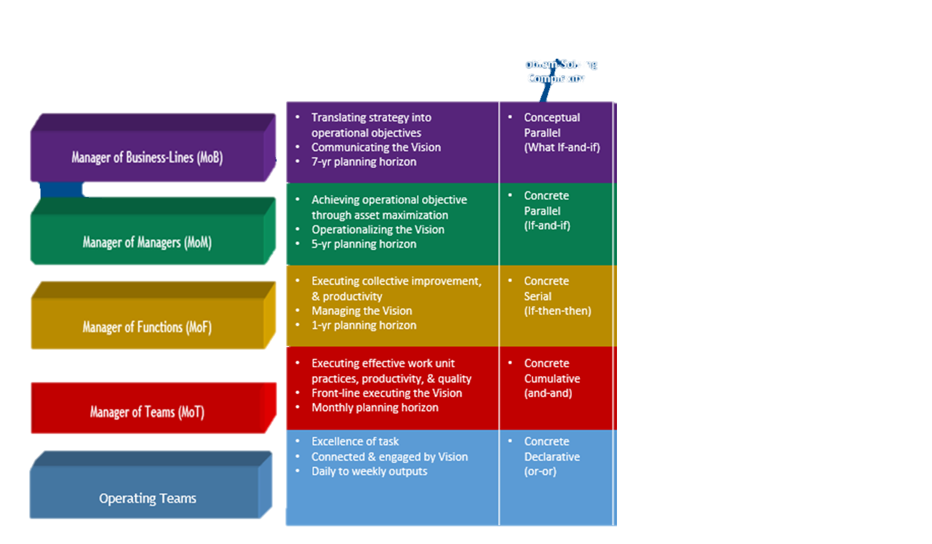
Benchmarked Leadership Competencies
EXAMPLE
Leadership Role-Specific Analytical Thinking Inventory
Analytical Thinking
Level of Work
Responsibility
Description
Involves applying ‘What-If' scenarios across multiple systems to explore potential outcomes, while managing inherent paradoxes
Manager of Business-Lines
Transformational
Problem solving involves Systems Thinking, recognizing the system as a whole and the interdependent relationships among its parts
Manager of Managers
Cause and Effect of problems are clearly understood, allowing for more lasting solutions developed through conditional logic and structured reasoning
Manager of Functions
Event patterns are recognized, and problems are anticipated, addressed proactively by Connecting-the-Dots
Manager of Teams
Problems are addressed individually as they arise, relying on known facts and established routines, with solutions developed through iterative Trial and Error
Operating Teams
WHERE STRATEGY MEETS PERFORMANCE
Notes:
Applying this to an organization, job roles, responsibilities, and complexities are identified
Applying this to TNA Production, the job roles refined, but the responsibilities and complexities technically remain the same
Those of you who are familiar with out Production Supervisors- it’s the difference between Charlie Avello and Shane Daniels

Slide 16
Benchmarked Leadership Competencies
EXAMPLE
Managers' Assessed Analytical Thinking — 45% of managers assessed demonstrated below-average capability in the analytical thinking required for team-based problem-solving
Abstract Analysis
(What if-and-if)
Managers of Business Lines
Conceptual Parallel
Cause & Effect
If-then-then)
1
1
Managers of Managers
Concrete Parallel
Systems Analysis
(if-and-if)
1
1
3
3
1
2
1
Managers of Functions
Concrete Serial
Managers of Teams
Concrete Cumulative
1
1
Trial & Error
(or-or)
Operating Teams
Concrete Declarative
20 25 30 35 40 45 50 55 60
Managers
WHERE STRATEGY MEETS PERFORMANCE
Notes:
Looking at an individuals career, the greater the complexity of job roles, the higher order problem-solving
Experience and education, have nothing to do with this. You are born with an innate ability that matures in a predictable pattern- what that means, is that from a problem-solving perspective, depending on what level you are at, an organization can match and groom your potential to a job role
Typically, an individual who is overmatched, becomes a performance issue, conversely, an individual who is under matched, becomes bored and is a retention issue

Slide 17
Leadership Competencies & Evaluaton
Manager Potential Grid (9-Box)
“Potential High Potential” High potential/ Low performance | “High Potential” High potential/ Moderate performance | “Star” High potential/ High performance
“Inconsistent Player” Moderate potential/ Low performance | “Core Player” Moderate potential/ Moderate performance | “High Performer” Moderate potential/ High performance
“Risk” Low potential/ Low performance | “Average Performer” Low potential/ Moderate performance | “Solid Performer” Low potential/ High Performance
High
Potential
Moderate
Low
Low
Moderate
High
Performance
WHERE STRATEGY MEETS PERFORMANCE
Notes:
`

Slide 18
Leadership Competencies & Evaluation
EXAMPLE
Manager Potential Grid (9-Box)
Potential to Improve?
Low/Med/High
Needs?
Promotable?
SV Upper Quantile
Potential
Emotional Intelligence, Problem-solving, Leadership Capabilities
SV µ
Potential to Improve?
Low/Med/High
Potential to Improve?
Low/Med/High
Needs?
G-Pop Benchmark
Competent
Disposition?
Potential to Improve?
Low/Med/High
Needs?
Performance
Performance Capability Appraisals, Productivity Management, Production Plan Targets
WHERE STRATEGY MEETS PERFORMANCE

Slide 19
PPI
Performance Partners International
PPI is a partnership in leading human capital management practices.
Our collaborations span all industries and business functions, guiding clients toward optimum organizational effectiveness through their people― where strategy meets performance…
For additional information or copies,
please call Larry Cummings +1 (770) 598-5809 or e-mail larry.cummings@perfpartintl.com
PPI
WHERE STRATEGY MEETS PERFORMANCE

